Slide 1


Slide 2
ONE
ENGINE
Powering Growth
of the Nation

Slide 3
ONE
STATE
Accounting for 25% of
the Country’s Exports
95% of the diamond exports in the country are from the state

Slide 4
ONE
ECONOMY
That Doubles itself
Every 7 Years
GDP Growth rate of more than 10% for the last 10 years

Slide 5
ONE
GEOGRAPHY
Where Manufacturing Growth is
among the Highest in the World
Annual Growth rate of more than 24%

Slide 6

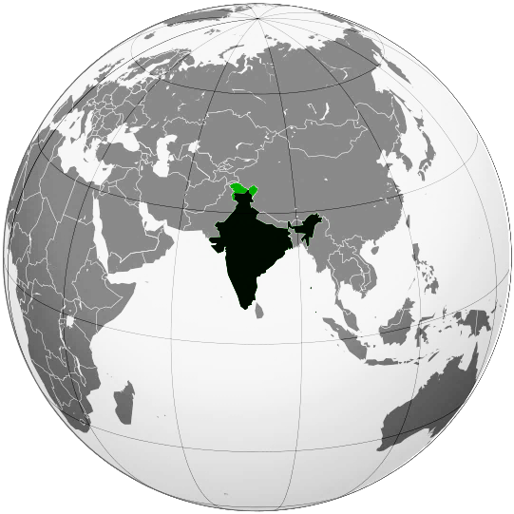
GUJARAT
Emanating the New Business Model of India to the World…
…now meets

Slide 7

THE POWER OF
1 MILLION BUSINESSES

Slide 8

THE LEAGUE OF
360 GLOBAL
ECONOMIC
HUBS

Slide 9

THE MIGHT OF FORTUNE 500 COMPANIES

Slide 10

AND THE
WORLD’S GREATEST BUSINESS MINDS

Slide 11

A Global Symbol of Business Prosperity & Regional Growth

Slide 12
AT
ONE
LOCATION

Slide 13
THAT IS
ASIA’s NEWEST GLOBAL
FINANCIAL HUB

Slide 14
THAT IS NOW THE
FOCUS OF GLOBAL CORPORATIONS

Slide 15
GIFT CITY
(GUJARAT INTERNATIONAL FINANCE TEC CITY)

Slide 16

Presenting
The New Epicentre of Growth

Slide 17


WHY
GUJARAT?

Slide 18
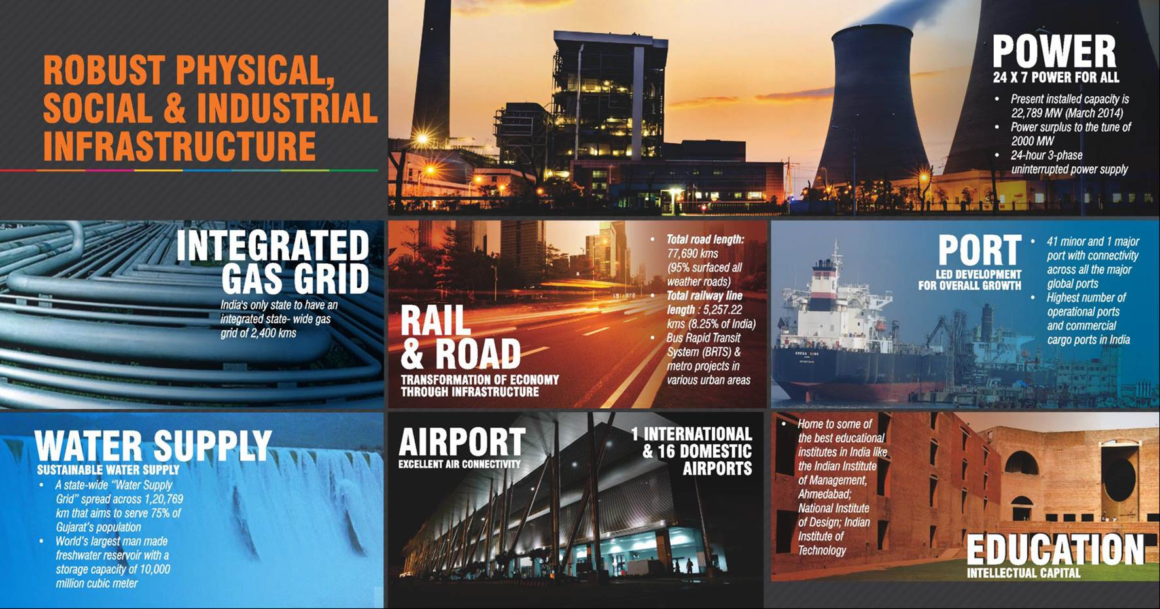
50% Higher GDP Growth Rate as compared to the National Average
GUJARAT

Slide 19
56% Higher Per Capita Income compared to the National Average
GUJARAT
GUJARAT
Ranked Number ONE
“Economic Freedom of the States of India 2012”
7.5% of India’s GDP
10% of India’s factories
9.5% of India’s skilled workforce
25% of India’s Exports
30% share in India’s Stock market Capitalisation
40% of India’s Total Port Cargo Management
Per Capita Income
Rs 75,115
Gujarat’s commendable growth has made it one of the most trustworthy places for Global Investors
SERVICES I NDUSTRY AGRICULTURE
Diverse & Strong Economic Base places Gujarat at par with Global economic Hubs
(Government of Gujarat)

Slide 20
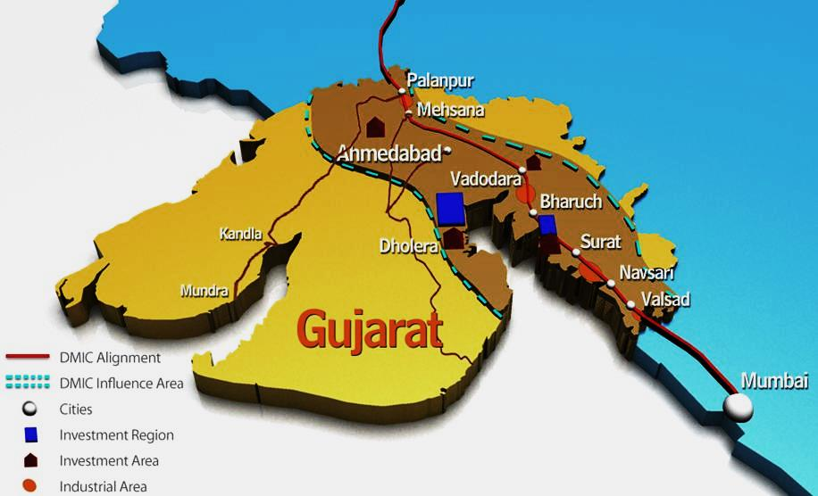
38% of the Total DMIC Construction Planned in Gujarat
GUJARAT
(DMIC - Delhi Mumbai Industrial Corridor)
DMIC is one of the biggest Infrastructure Projects in the country, developed as a Growth Corridor.
More than 60% of total Investment is likely to be in Gujarat
DMIC which is 50% funded by the Japan Government has an investment potential of USD 90 Billion.
DMIC will be a high impact industrial area with 150 km distance on both sides of Dedicated Freight Corridor (DFC).
The Services Sector is poised to be on a fast growth track

Slide 21
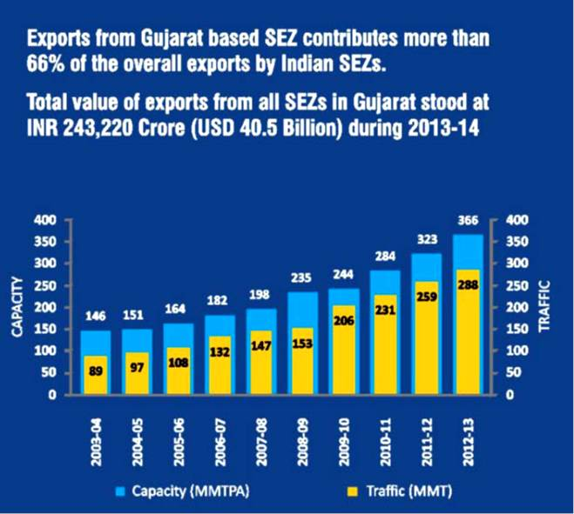
GUJARAT
An Economy that leads the way
Power Surplus State
Global Auto Hub with Clusters
Spinning India’s Textile Success with an estimation of USD 25 Billion related turnover by 2017
Pharmaceutical Hub with state of the art manufacturing facilities
Glittering state contributing to 95% of total diamond exports from India
Intellectual Capital with a high literacy rate of 79%.
(Government of Gujarat)

Slide 22

And Now Gujarat is
INCUBATING A FINANCIAL CENTRE

Slide 23
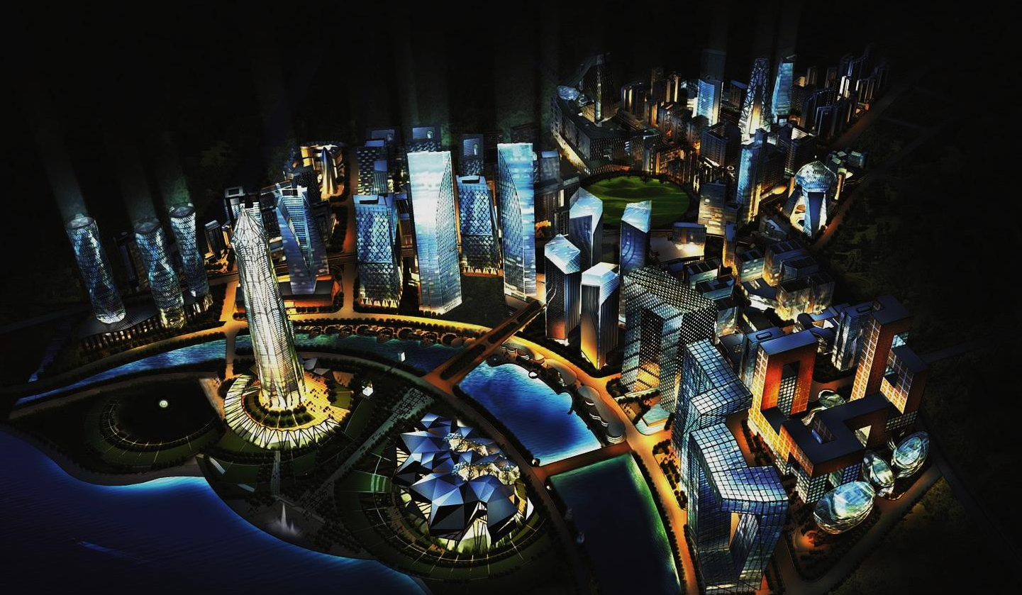
INDIA’s 1st GLOBAL FINANCIAL HUB

Slide 24
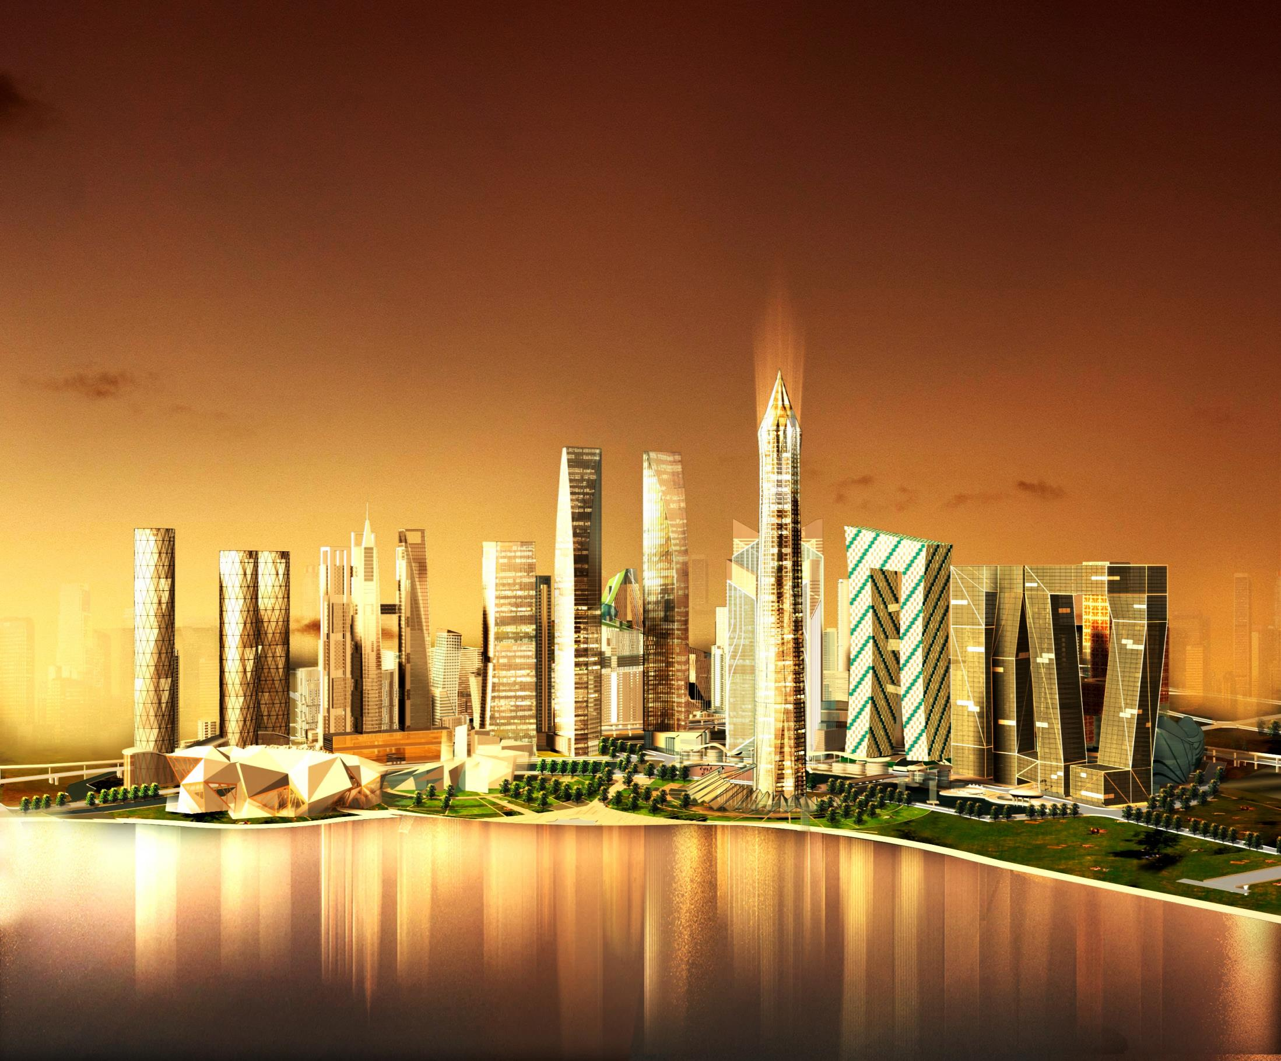
POTENTIAL TO CREATE A MILLION JOBS

Slide 25
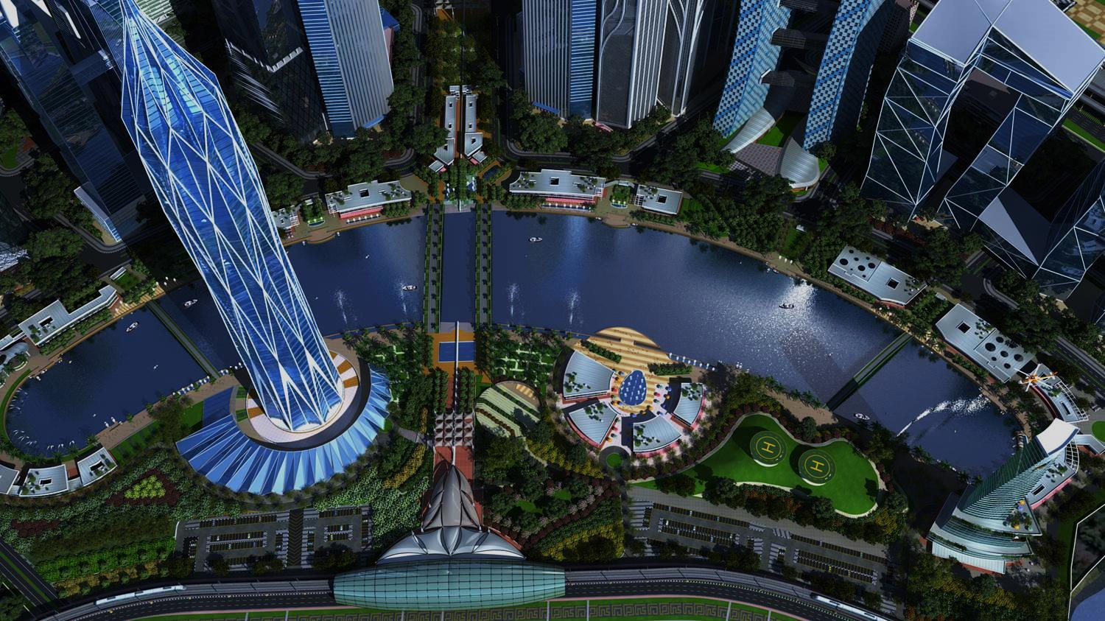
Matching the GDP of Brunei in Investment Size
(More than INR 75000 Crores worth of Investment is planned)
Networking with the World’s Best Business Hubs
(MOUs with Dubai International Financial Centre & others)
Communicating better than Singapore with the World
(ASIA’s largest Data Centre is being setup in GIFT City)

Slide 26
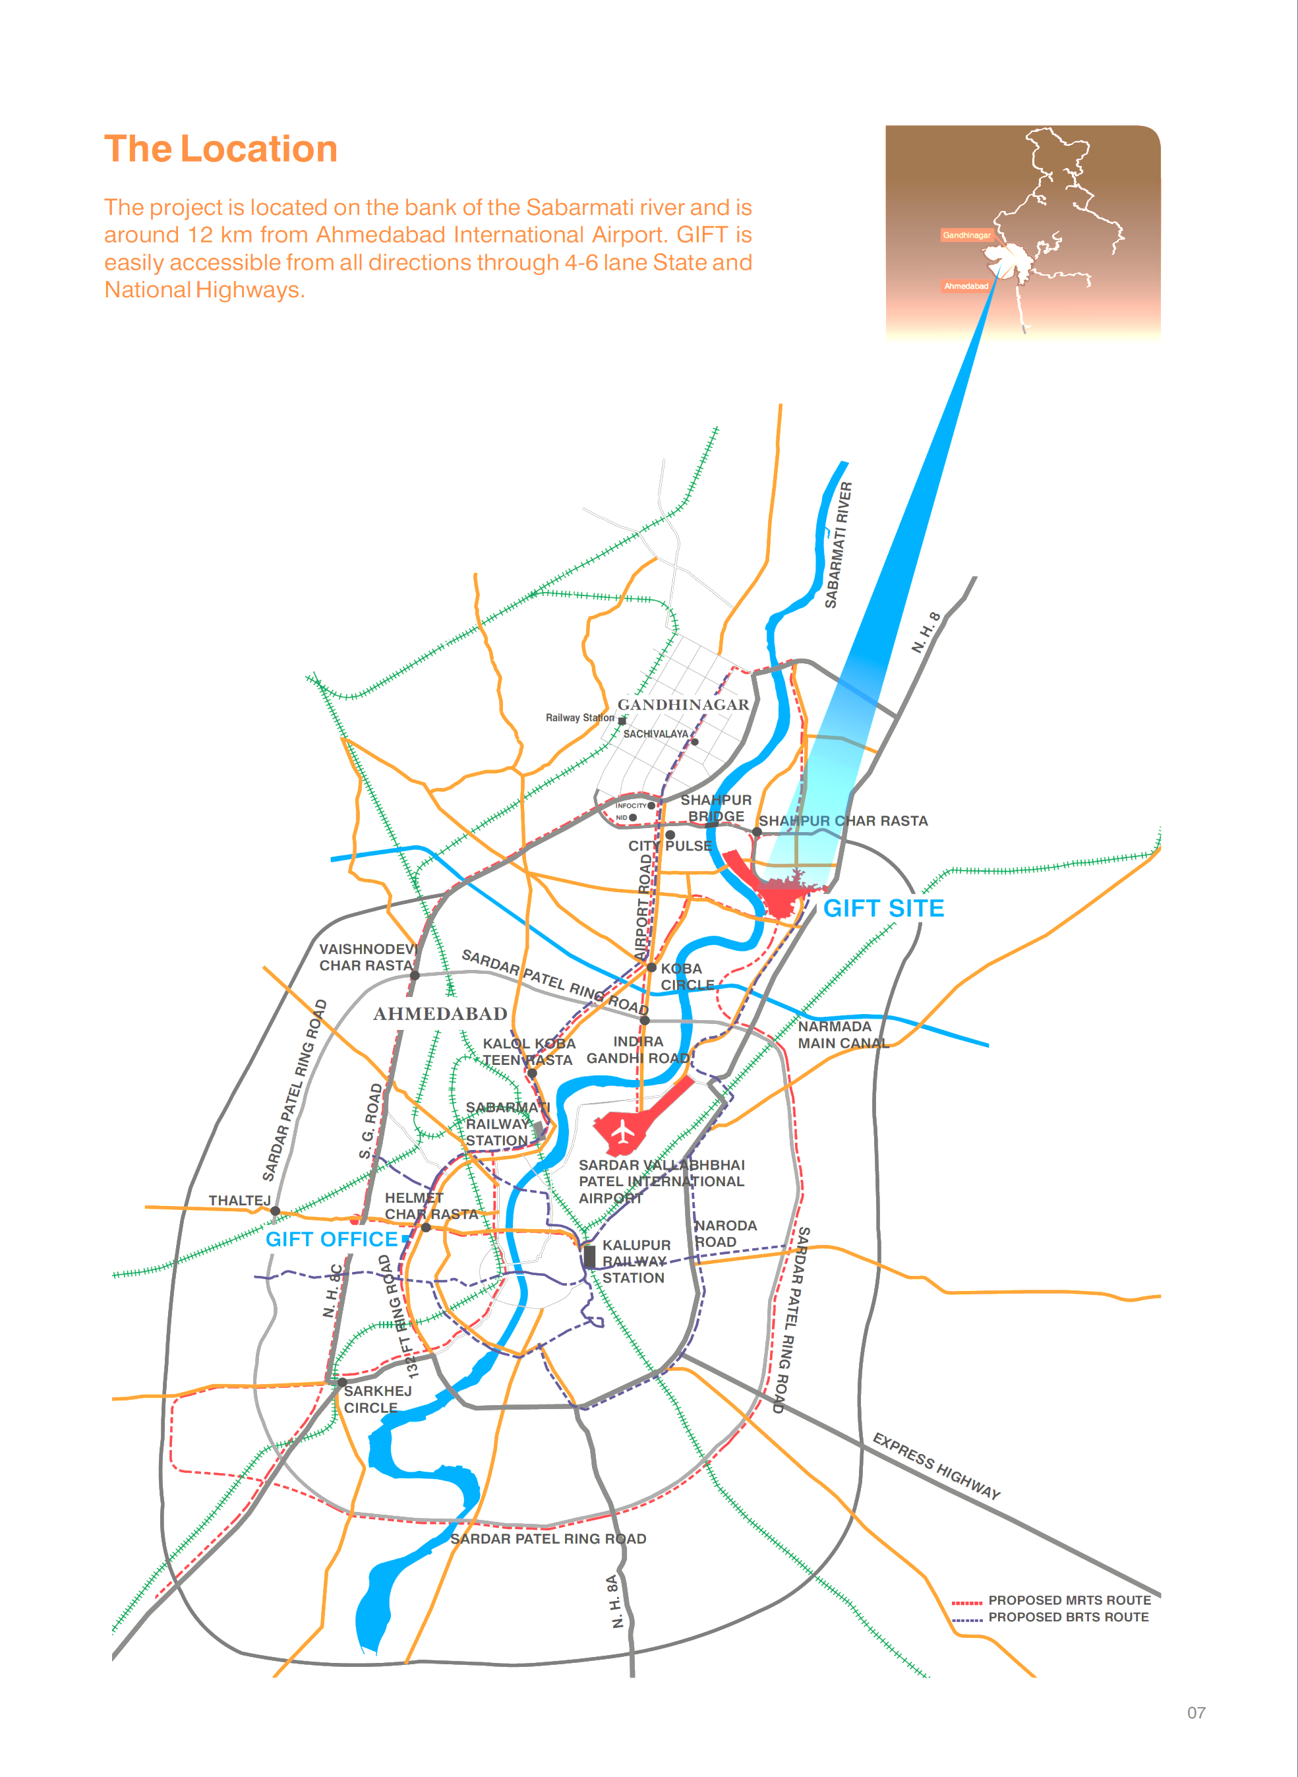
STRATEGICALLY
LOCATED
    GIFT City is 12 KM from the Ahmedabad International Airport and 8 KM from Gandhinagar.
    The site abuts a four lane National Highway (NH8) which connects Ahmedabad and Gandhinagar on its eastern side and the Sabarmati River demarcates the western boundary.
    As part of the Ahmedabad Metropolitan Region

Slide 27
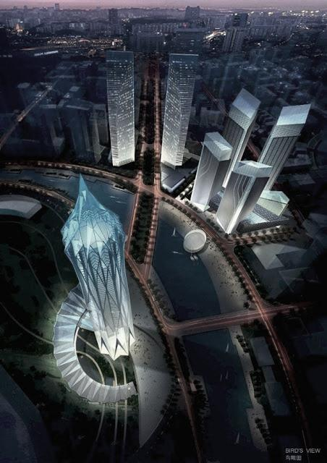


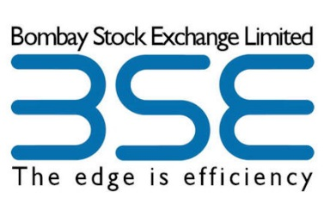








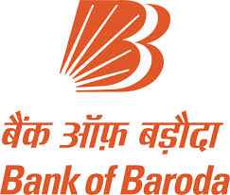



ENABLING BUSINESSES
Investors, Consultants & Tenants at GIFT CITY

Slide 28
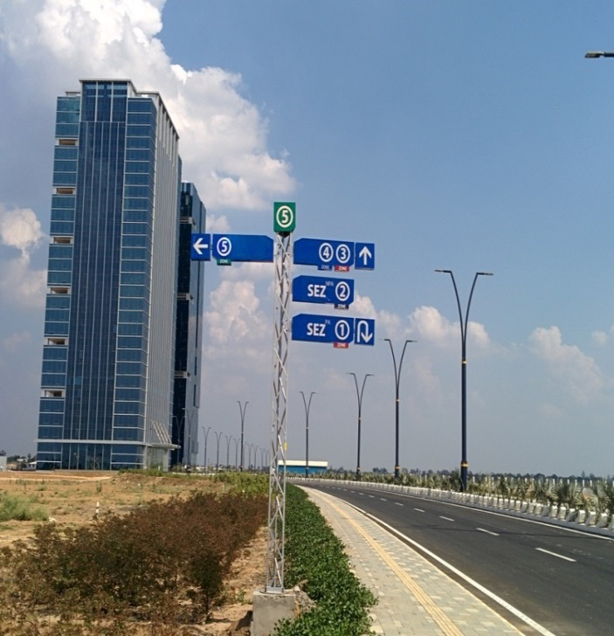
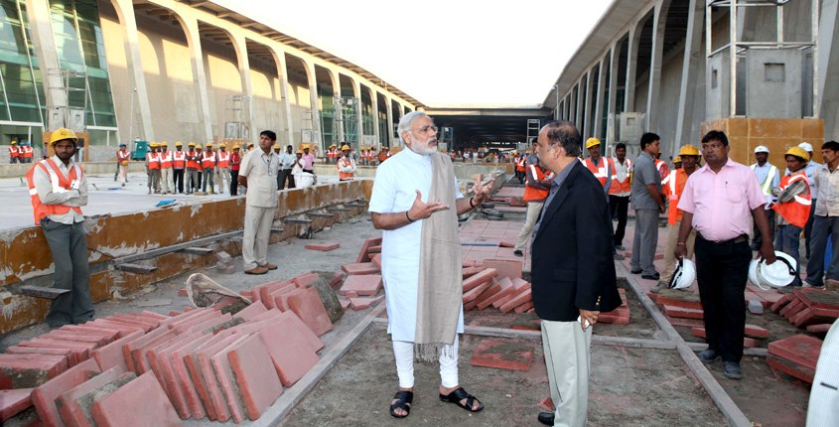
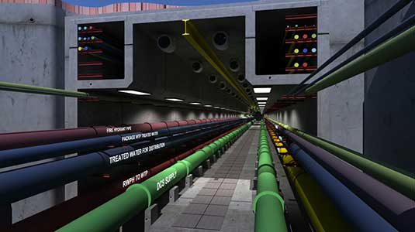
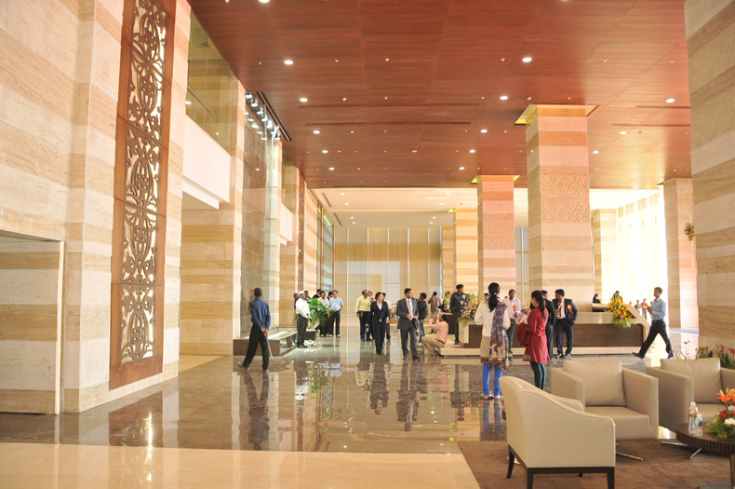
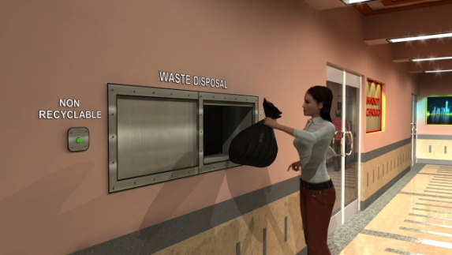
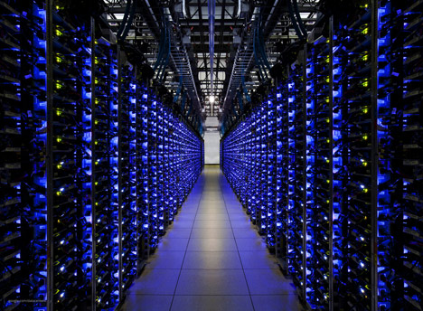
IT IS THE STORY OF TODAY
Indian PM being updated on the construction
Underground Utility Tunnel developed around the city
GIFT 1 & GIFT 2
100% occupancy in GIFT 1
Automated Waste Collection System
ASIAs largest Green Data Centre

Slide 29
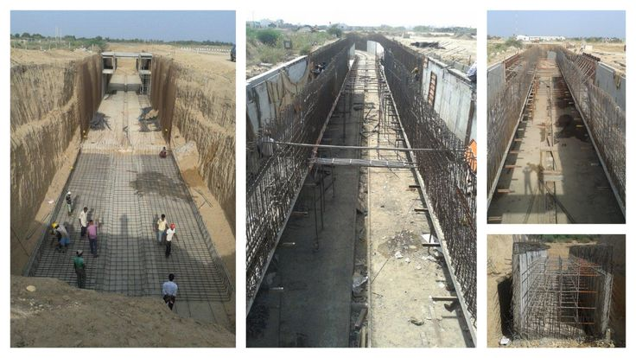
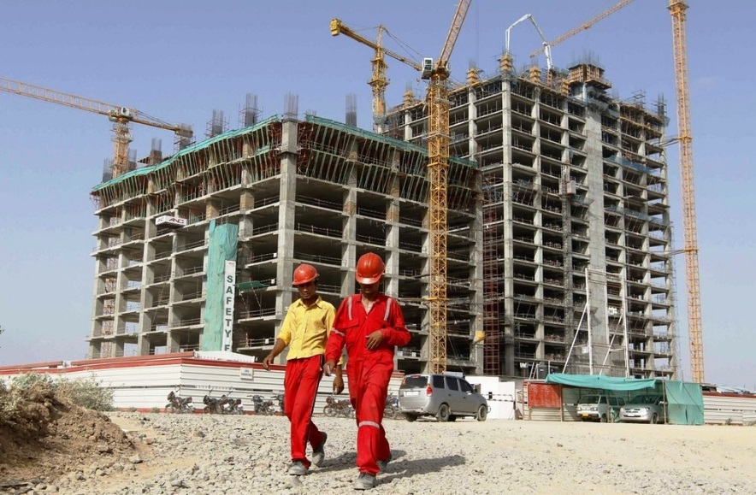
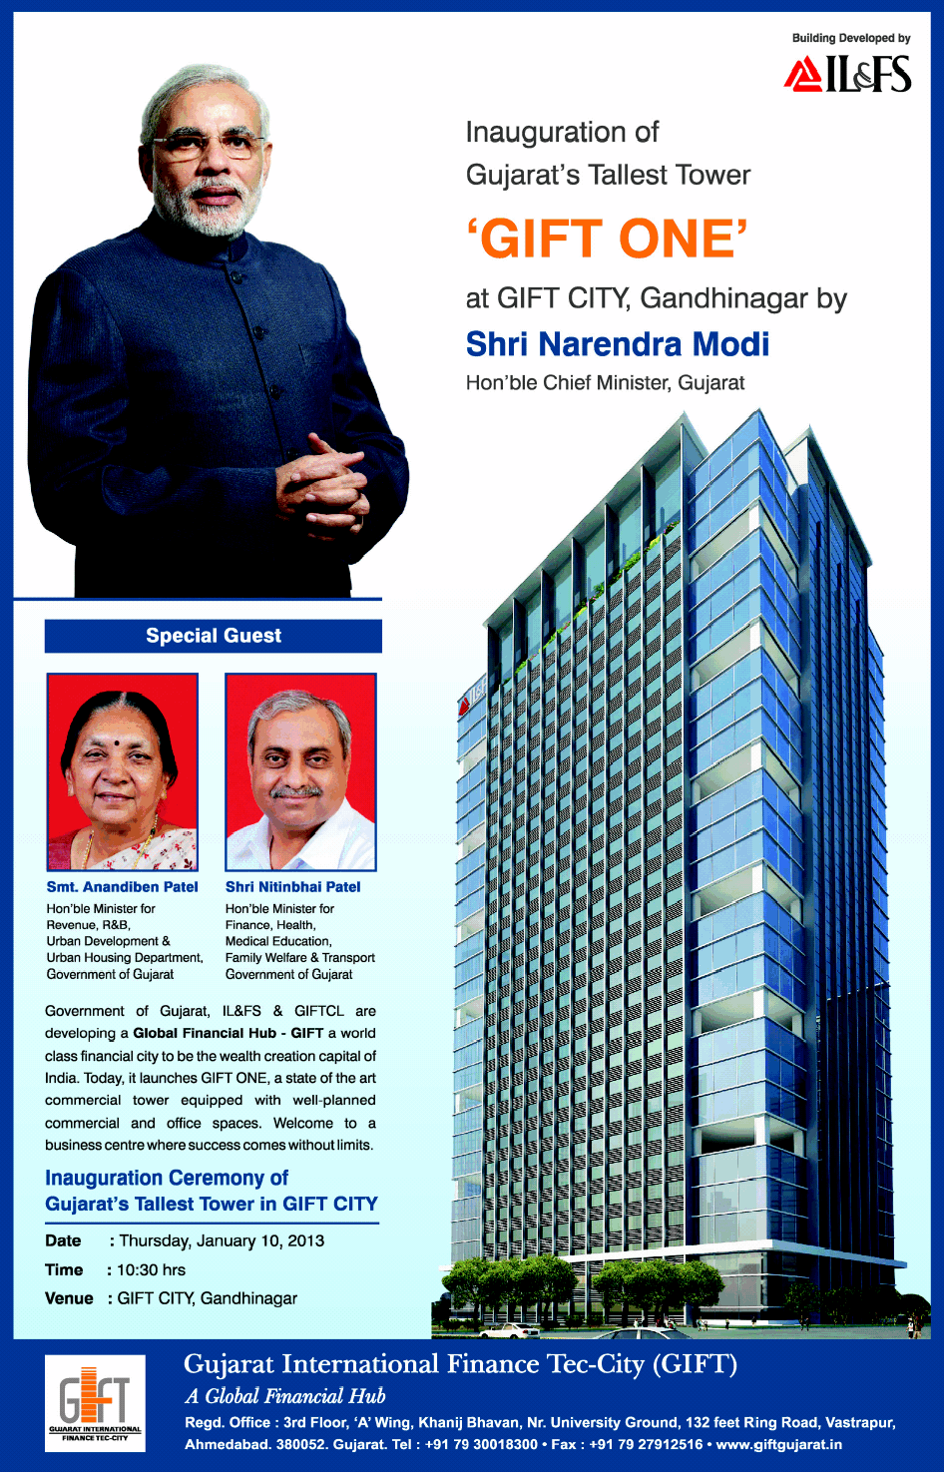
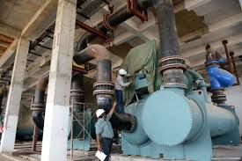
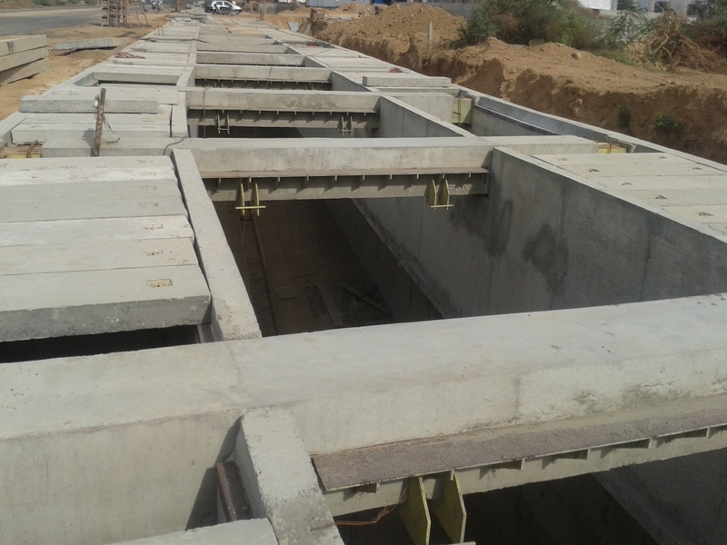
IT IS THE STORY OF TODAY

Slide 31
AND GIFT CITY IS NOW ALL SET
TO EXPERIENCE THE
Power of Transformation

Slide 32
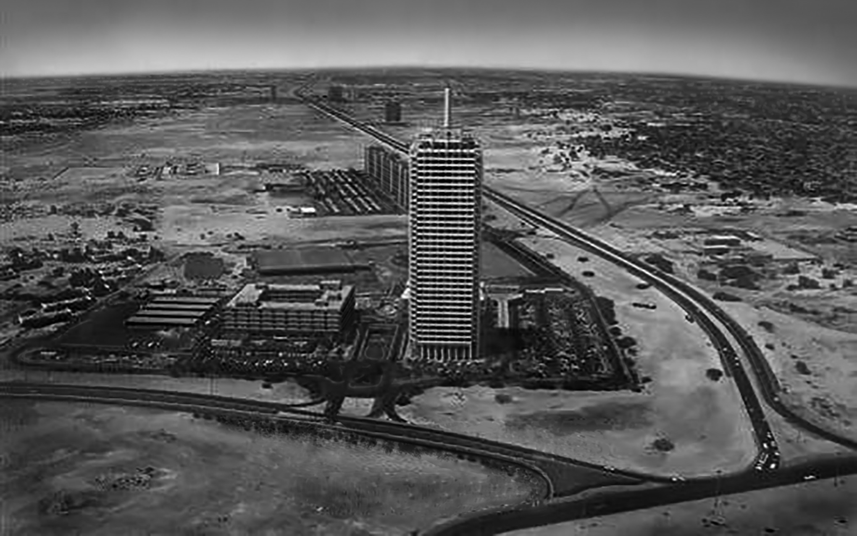
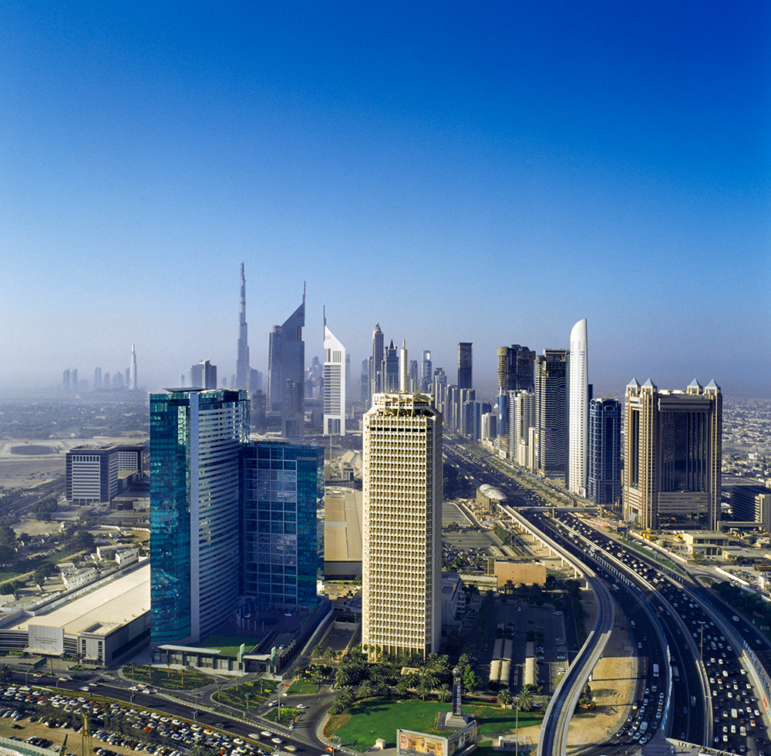
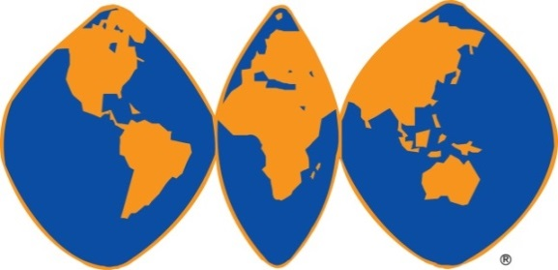
Dubai in 1979
Dubai in 2014
“Transformational
Impact of a WTC”

Slide 33
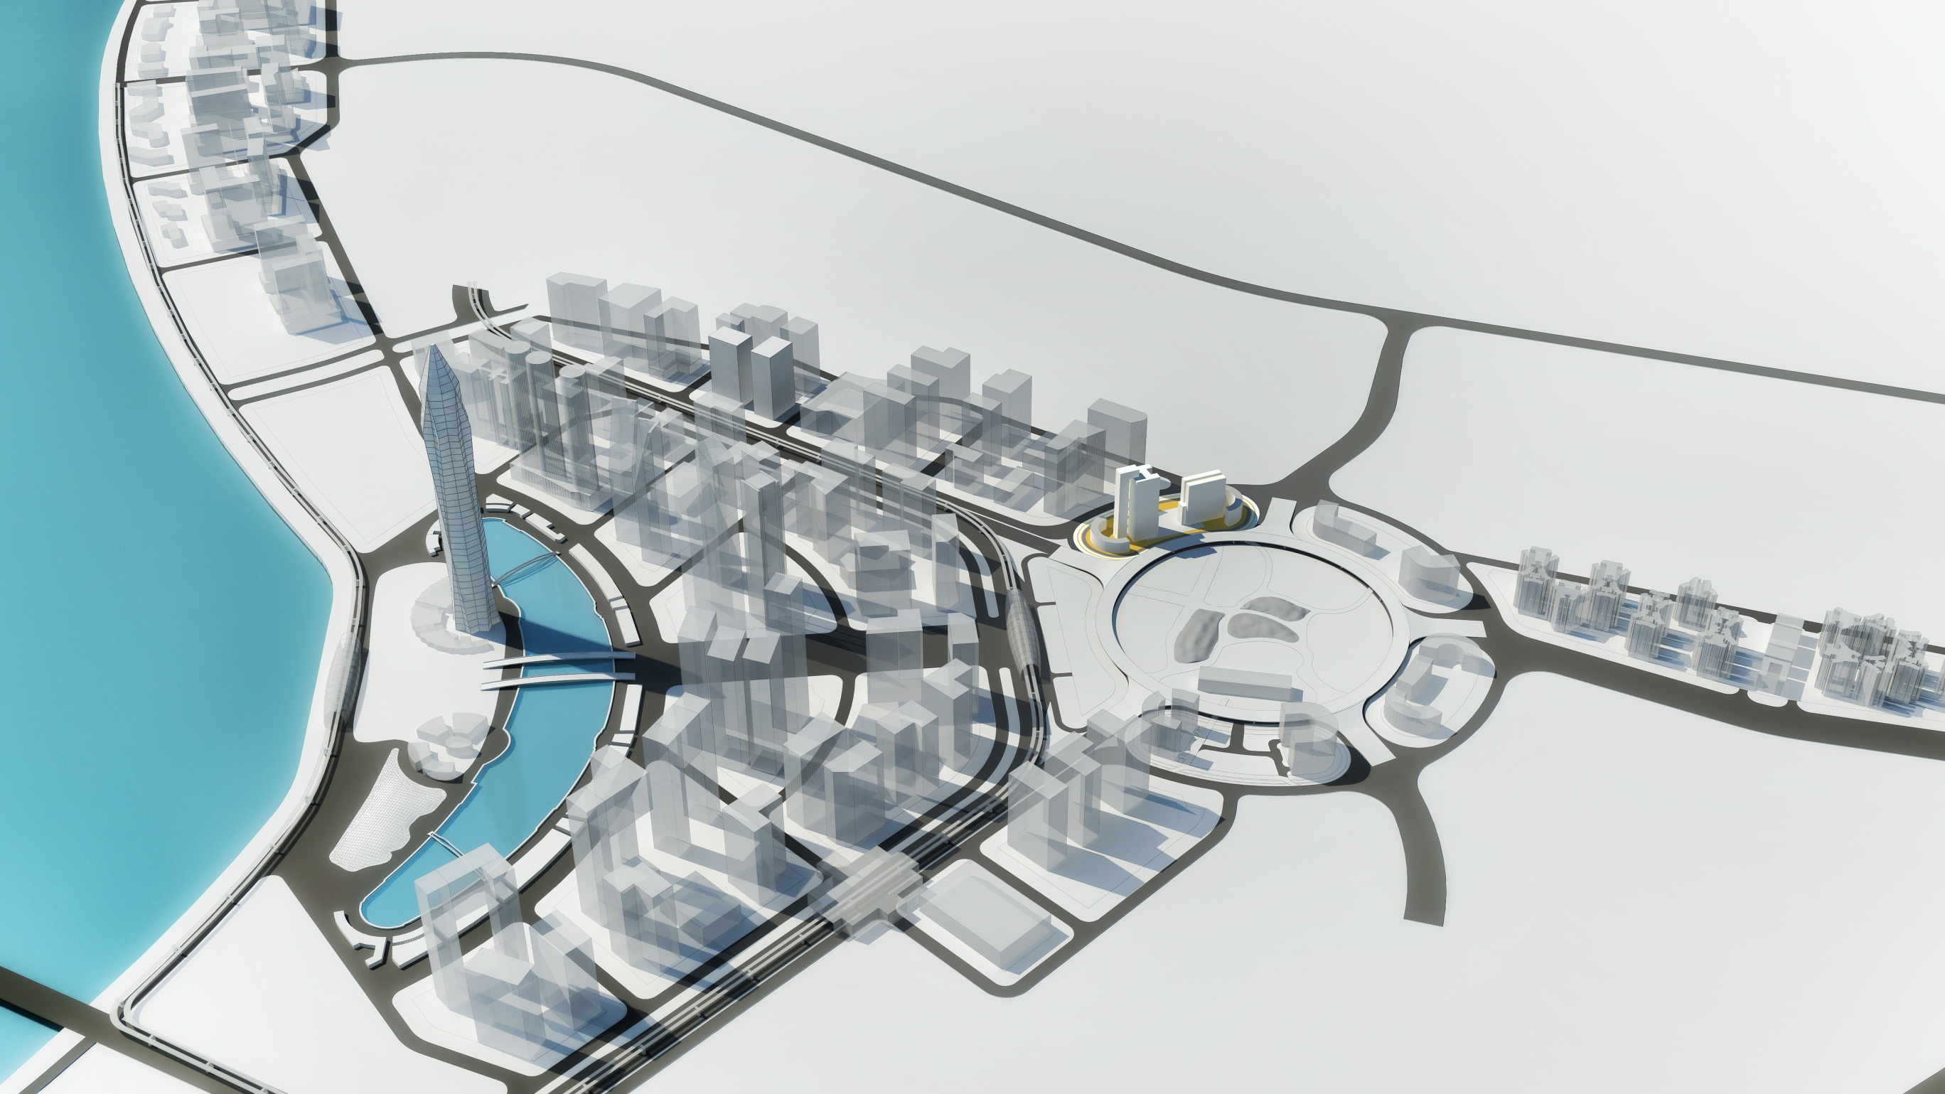

GIFT 1 & GIFT 2
MULTI LEVEL
CAR PARK
CURRENT ENTRY
HOTEL
NATIONAL HIGHWAY
METRO STATION

Slide 34
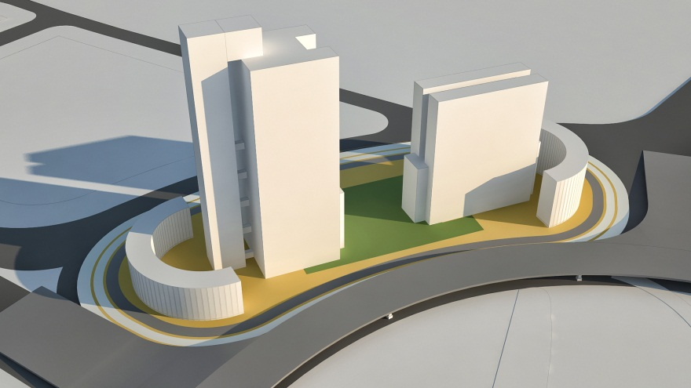
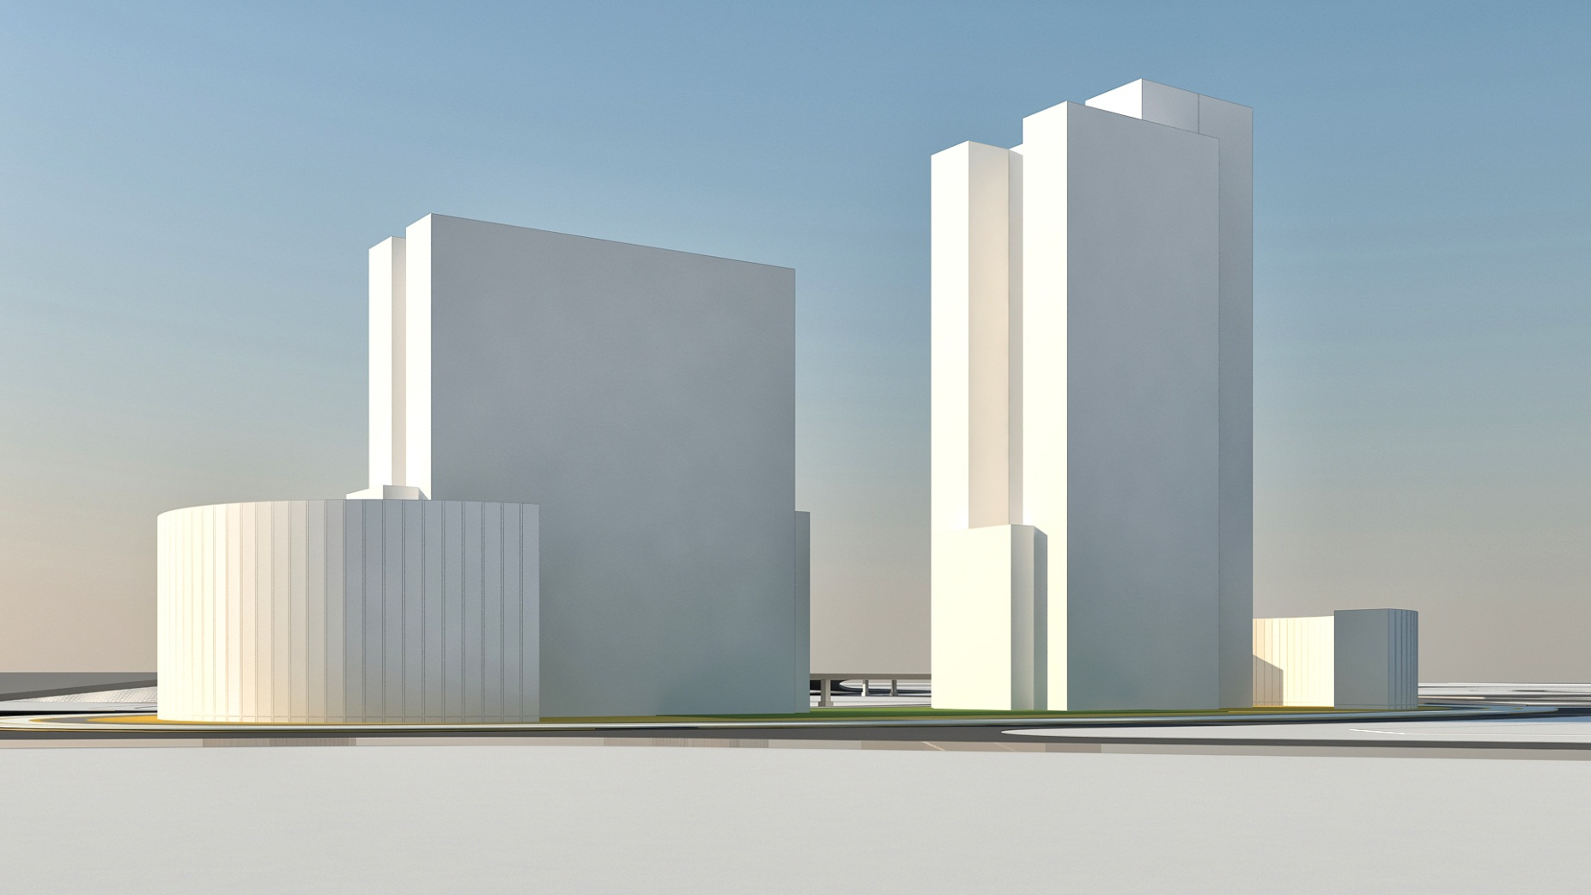
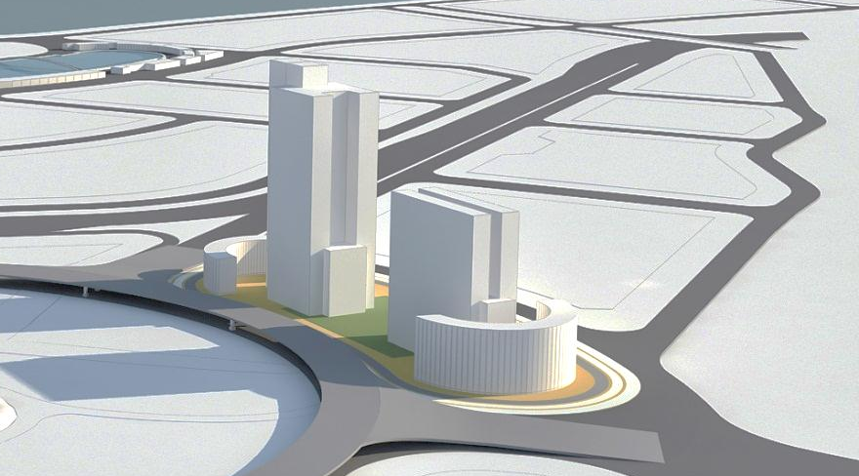

Slide 35
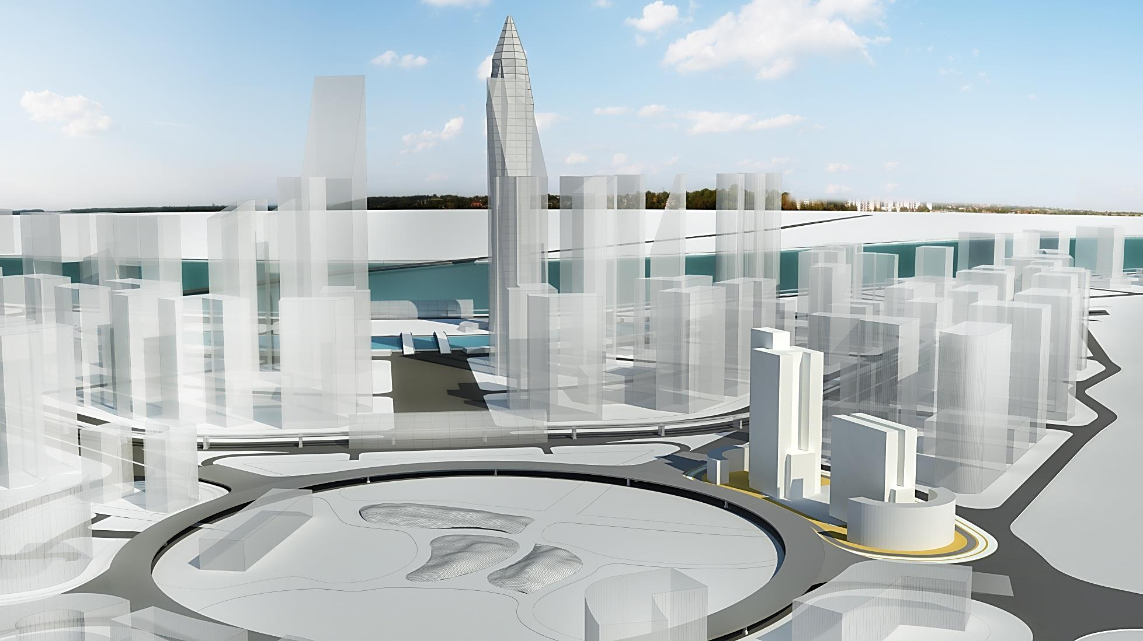

Slide 36
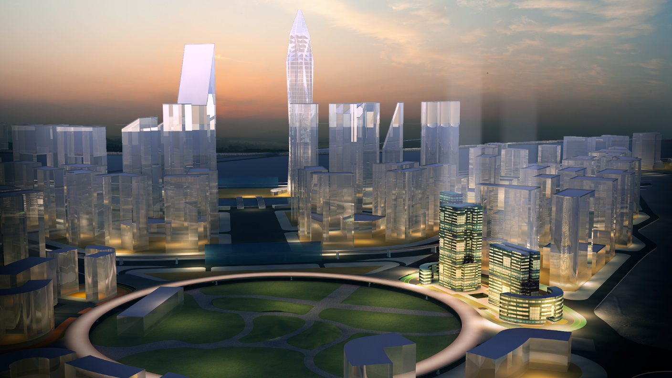

Slide 37
The New Epicentre of Growth is…

Slide 38

…A STRATEGIC INVESTMENT enabling
SECURITY OF INVESTMENT
HIGH RETURNS
CAPITAL APPRECIATION
PRIDE OF OWNERSHIP

Slide 39

WTC as a GLOBAL POWER BRAND has been delivering profitable opportunities to a million businesses for more than 40 years.
Security of Investment
GIFT City, the vision of Indian Government is being made as per International Infrastructure Standards and will be operating as INDIA’s GLOBAL FINANCIAL HUB

Slide 40

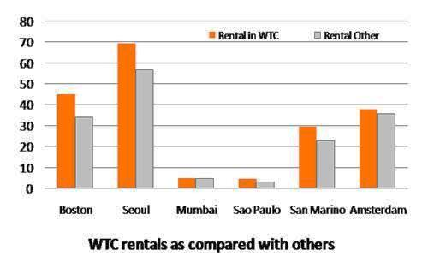
WTCs across the globe on an average enjoys 33% HIGHER OCCUPANCIES & 18% HIGHER RENTALS
(As per international case studies by WTCA)
High Returns
WTC GIFT City will be constructed as per the Global Standards of WTC, thereby attracting higher rentals and occupancies than its counterparts in the adjoining areas.

Slide 41

WTCs are proven to be catalysts of REGIONAL DEVELOPMENT thereby significantly improving their own capital values over a period of time as compared to other commercial complexes
(Case Study – Dubai WTC)
Capital Appreciation
Being among the first list of allottees, WTC GIFT City enjoys the First Mover Advantage which ensures that Capital Values are all set to increase in the coming years.

Slide 42
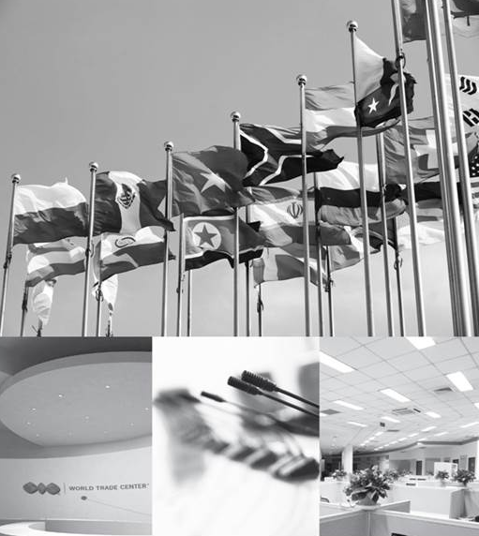
WTCs are LANDMARKS IN THE REGION THEY SERVE and become highly desirable complexes providing a unique & strong differentiation to the owners
Pride of Ownership
ELITE GLOBAL BUSINESS CLUB is the highlight of each WTC as part of the international network. Stakeholder instantly gets access to this membership and enjoys reciprocal benefits in various WTCs.

Slide 43
Brought to you by
VIRIDIAN RED
Disclaimer - World Trade Center, WTC and Map Design Logo are the registered trade marks of the World Trade Centers Association, Inc., New York (WTCA), and WTC Noida Development Company Pvt. Ltd. - a group company of Viridian, has entered into a License Agreement with World Trade Centers Association, Inc., to use the name ‘WORLD TRADE CENTER’, ‘WTC’ and Map Design logo of World Trade Center for the GIFT City project as “WORLD TRADE CENTER GIFT CITY” and “WTC GIFT CITY”. All the information and statistical data herein have been obtained from sources we believe to be reliable, such information has not been independently verified and we make no representation or warranty as to its accuracy, completeness or correctness. The Brand names and logos used herein are registered trademark of their respective companies. Any unauthorized use thereof in any manner is prohibited.

Slide 44
Viridian RED
Transform. Impact. Inspire
With a vision to deliver innovative and quality real estate solutions, Viridian Real Estate Development was established as a vital part of Viridian’s Integrated Platform, comprising of Investment Management, Real Estate Development and Asset Management functions.
Viridian RED is highly awarded and recognized for its development of mainstream global landmarks and related ecosystems that deliver growth through innovation and excellence.
Viridian RED firmly believes its fundamental purpose is to help create wealth and security for its customers and therein all other stakeholders. Thus, across its projects the focus is on LTAV or high capital appreciation with the highest levels of income generation and rentals across both commercial and residential asset classes.
With c 20 Million sqft. of Commercial Office, Hotels, and Residential units developed or currently under development, the Group is a strong proponent of sustainable development. Its ‘Mainstream Green’ philosophy has had an outsized impact, not only on its teams pursuing the challenge, but also on the green building movement as a whole, and each of the communities where Viridian’s operations are located.
Viridian RED is further setting new benchmarks by taking the immense potential of the World Trade Center to all of India. The company has already planned a strategic roadmap for a comprehensive rollout of WTC’s across India and ASEAN.

Slide 45
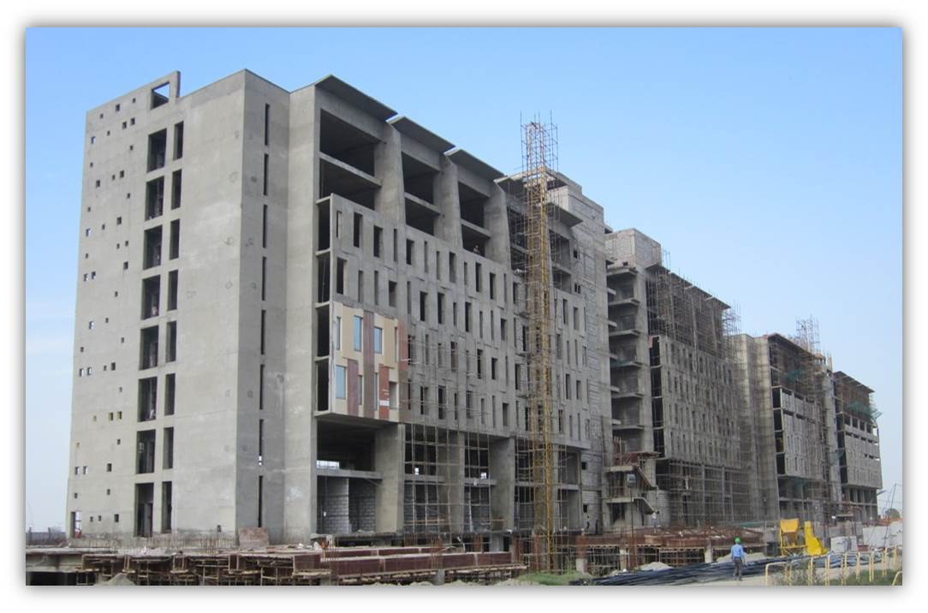
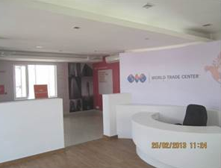
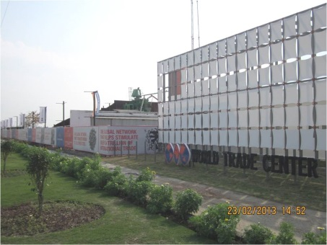
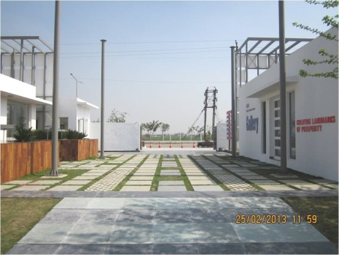
WTC Noida ready for possession handover in Dec’14

Slide 46
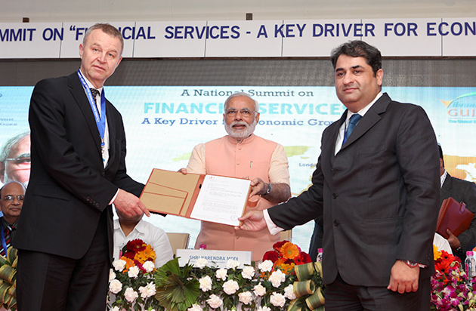
Land Allotment to MD, VIRIDIAN RED & CEO, WTCA
by Mr. Narendra Modi in Feb 2014

Slide 47
Sizes Available (Sq.ft) | 500 & multiples of 500
Type | Unlockable & lockable
Basic Selling Price (INR) / Sq-ft | 6550
Assured Return % | 12%, 11%, 10%
Assured Return Schedule | 4 years or possession whichever is later
Booking Amount (INR) | 2, 00, 000
5 Different Payment Plans & More………Please check the attached Payment Plans

Slide 48
THANK YOU

